Slide 1
Midterm Exam
Part 1

Slide 2

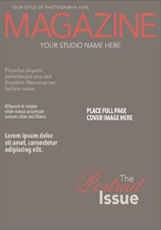
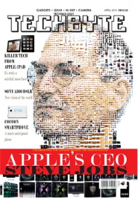

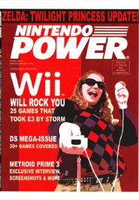
Create an HTML page that would look like this:
CS 2205 – Midterm Exam
?
Select A Magazine

Slide 3
Create an HTML page that would look like this:
CS 2205 – Midterm Exam
?
Create this with pure HTML/CSS
Select A Magazine

Slide 4
Create an HTML page that would look like this:
CS 2205 – Midterm Exam
Clicking on an image would show a larger version.
?
2
Larger Image Appears
1
Click on Pic.
Parent Child
3
Magazine Title Text Appears

Slide 5
Create an HTML page that would look like this:
CS 2205 – Midterm Exam
Clicking on the larger image would display it’s back version.
?
1
Click on this
Parent Child

Slide 6
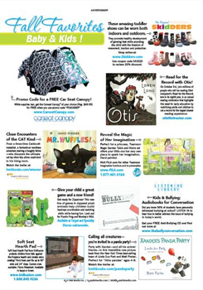
Create an HTML page that would look like this:
CS 2205 – Midterm Exam
Clicking on the larger image would display it’s back version.
This happens
2
Parent Child (Front + Back)
3
Note the title change

Slide 7
Create an HTML page that would look like this:
CS 2205 – Midterm Exam
Clicking on the “back version” would cause it to go back to front view only.
?
1
Revert to front view
Parent Child

Slide 8

Additional Notes
Make sure I can click on all 5 magazines and show them correctly.
When I am currently viewing the front and back view portion, clicking on another magazine thumbnail should result in showing only the front view.
Maximize your CSS/JS Frameworks. Less code == better. Try using col-md-* for your alignments, and .hide() / .show() for your triggers.
For Additional Points:
Hide/Show Animation/Transition Effects
Highlighting / Shadow-outline for active thumbnail
selected
default

